Slide 1

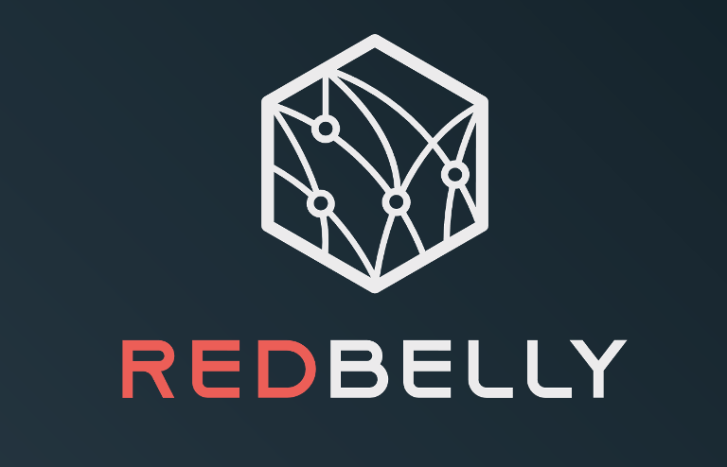
ZLB: A Blockchain to Tolerate Colluding Majorities
Science and Engineering of Consensus 2024 Cornel Tech, New York
Alejandro Ranchal-Pedrosa and Vincent Gramoli
Notes:
Before starting, I acknowledge the Jugera (Yug-er-a) people and the Turrbal (Tur-a-bul) people as the Traditional Custodians of Meanjin, the lands on which we gather today and pay my respects to Elders past, present and emerging.

Slide 2
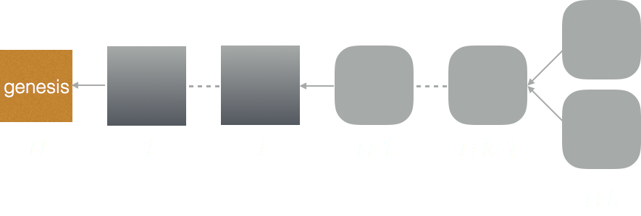
Blockchain forks
Consensus attempt succeeded
Consensus attempt succeeded
Consensus attempt succeeded
Consensus attempt succeeded
Consensus attempt failed
The University of Sydney

Slide 3
Double spending
If the consensus failure persists, then a hacker can double spend, effectively stealing assets
Classic blockchain can only tolerate a minority of failures and require synchrony (all messages to be delivered in less than a known bounded amount of time).
The balance attack or why forkable blockchains are ill-suited for consortium. C Natoli, V Gramoli. 47th Annual IEEE/IFIP International Conference on Dependable Systems and Networks (DSN), 2017.
Consensus attempt failed
The University of Sydney

Slide 4
Eventually consensus must be reached
Consensus instance k
Consensus attempt succeeded
Consensus attempt succeeded
Consensus attempt succeeded
Consensus attempt succeeded
Consensus attempt failed
Consensus attempt succeeded
The University of Sydney

Slide 5
The Longlasting Blockchain (LLB) Problem
time
Consensus instance k
Consensus attempt 1: failure
Consensus attempt 2: failure
Consensus attempt j: success
LLB Termination: Every consensus attempt terminates
The University of Sydney

Slide 6
The Longlasting Blockchain (LLB) Problem
time
Consensus instance k
Consensus attempt 1: failure
Consensus attempt 2: failure
Consensus attempt j: success
LLB Convergence: there is a finite number of failures after which there is a success
The University of Sydney

Slide 7
How to tolerate a majority of failures?

Slide 8

Failure Paradigm Shift
From liveness violations in closed networks: distributed systems (datacenters, distributed databases, cloud) experiencing mostly omissions faults.

Slide 9
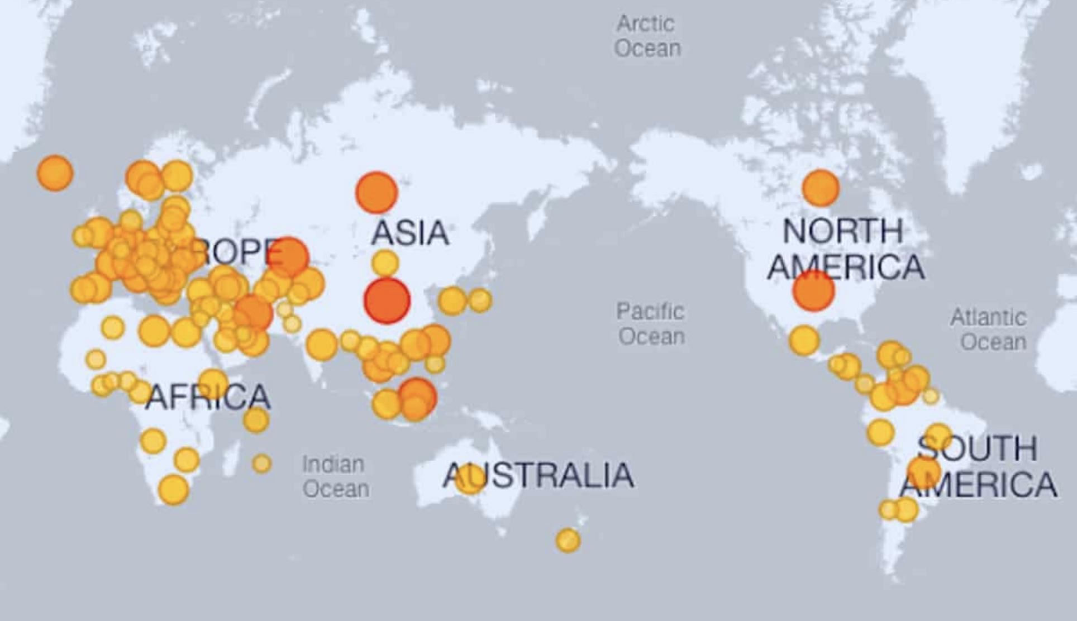
Failure Paradigm Shift
To safety violations in open networks: blockchain networks are open networks that incentivize nodes to be active (either by contributing or stealing).
From liveness violations in closed networks: distributed systems (datacenters, distributed databases, cloud) experiencing mostly omissions faults.

Slide 10
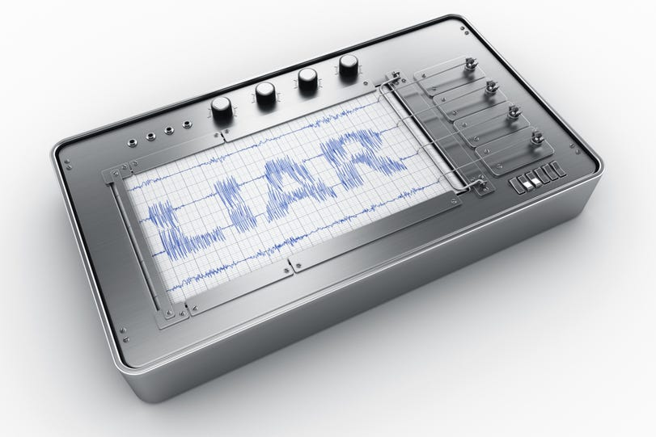
Accountable Consensus
Polygraph: Accountable Byzantine agreement. P Civit, S Gilbert, V Gramoli. DISC 2020, ICDCS 2021, arXiv 2019.
The University of Sydney

Slide 11
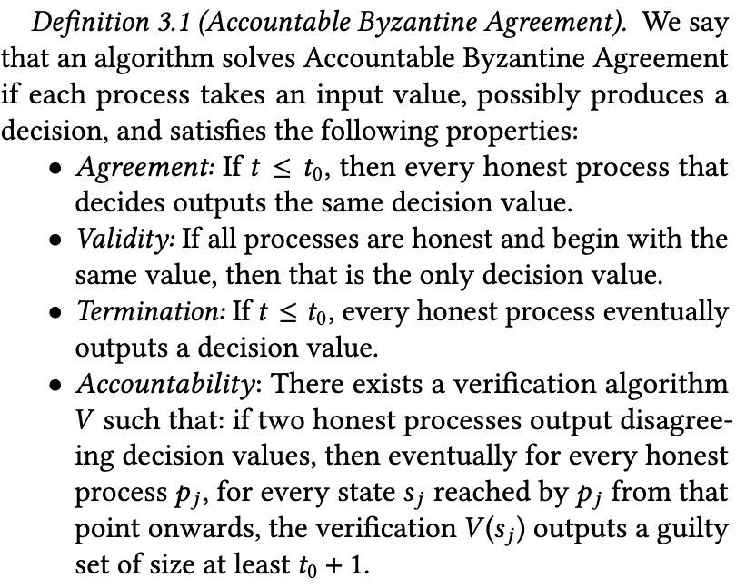
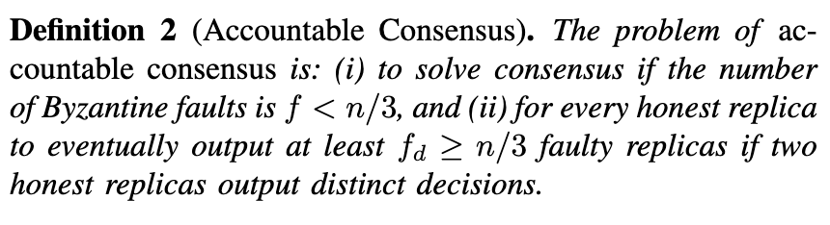
Accountable Consensus
Polygraph: Accountable Byzantine agreement. P Civit, S Gilbert, V Gramoli. DISC 2020, ICDCS 2021, arXiv 2019.
The University of Sydney

Slide 12
The Zero Loss Blockchain Solution
We need to get rid of the synchrony assumption, so that consensus can be reached despite network attacks
We bound the number of participants that run consensus at a time to ensure consensus is reached deterministically
We use an accountable consensus algorithm that tolerates any number of failures to identify misbehaving participants
We remove or replace these participants when identified and repeat the step above to finally reach a state where consensus is reached successfully.
The University of Sydney

Slide 13
The Zero Loss Blockchain Solution
We assume partial synchrony as consensus is unsolvable
with asynchrony
We need to get rid of the synchrony assumption, so that consensus can be reached despite network attacks
We bound the number of participants that run consensus at a time to ensure consensus is reached deterministically
We use an accountable consensus algorithm that tolerates any number of failures to identify misbehaving participants
We remove or replace these participants when identified and repeat the step above to finally reach a state where consensus is reached successfully.
The University of Sydney

Slide 14
The Zero Loss Blockchain Solution
We use DBFT with the superblock optimization as in Redbelly to scale to large number of nodes
We need to get rid of the synchrony assumption, so that consensus can be reached despite network attacks
We bound the number of participants that run consensus at a time to ensure consensus is reached deterministically
We use an accountable consensus algorithm that tolerates any number of failures to identify misbehaving participants
We remove or replace these participants when identified and repeat the step above to finally reach a state where consensus is reached successfully.
Red Belly: A secure, fair and scalable open blockchain. T Crain, C Natoli, V Gramoli. IEEE Symposium on Security and Privacy (S&P), 466-483, 2021
The University of Sydney

Slide 15
The Zero Loss Blockchain Solution
We need to get rid of the synchrony assumption, so that consensus can be reached despite network attacks
We bound the number of participants that run consensus at a time to ensure consensus is reached deterministically
We use an accountable consensus algorithm that tolerates any number of failures to identify misbehaving participants
We remove or replace these participants when identified and repeat the step above to finally reach a state where consensus is reached successfully.
We use the Polygraph algorithm to solve the accountable consensus problem for any number of faults
Red Belly: A secure, fair and scalable open blockchain. T Crain, C Natoli, V Gramoli. IEEE Symposium on Security and Privacy (S&P), 466-483, 2021
The University of Sydney

Slide 16
The Zero Loss Blockchain Solution
We need to get rid of the synchrony assumption, so that consensus can be reached despite network attacks
We bound the number of participants that run consensus at a time to ensure consensus is reached deterministically
We use an accountable consensus algorithm that tolerates any number of failures to identify misbehaving participants
We remove or replace these participants when identified and repeat the step above to finally reach a state where consensus is reached successfully.
We converge towards a state where sufficiently many honest participants reach consensus
Red Belly: A secure, fair and scalable open blockchain. T Crain, C Natoli, V Gramoli. IEEE Symposium on Security and Privacy (S&P), 466-483, 2021
The University of Sydney

Slide 17
Assumptions
A slowly adaptive adversary selects at most f < 5n/9 faulty consensus participants among n participants during each consensus instance.
Among the f faulty nodes:
t < n/3 are Byzantine (arbitrary failures)
f-t are alive-but-corrupt (faulty but active) *
We assume a public-key infrastructure that associates participants to their public key
We assume a large pool of m >> n nodes where 2n/3 are honest and m-2n/3 are alive-but-corrupt from which new consensus participants are selected.
n = 90, f = 49 (t = 29, f-t = 20)
* Flexible Byzantine fault tolerance. D. Malkhi, K. Nayak, and L. Ren. CCS 2019.
The University of Sydney

Slide 18
Experimental Evaluation

Slide 19
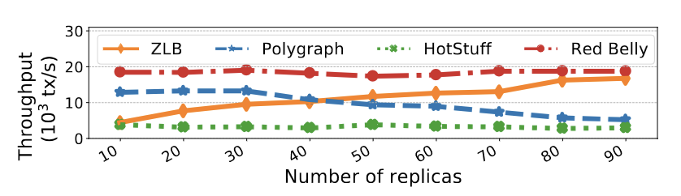
Performance of Zero Loss Blockchain (ZLB)
Geodistributed experiments: California, Oregon, Ohio, Frankfurt and Ireland.
Up to 90 machines, each with 4 vCPUs and 7.5 GiB of memory on AWS
Plotted values averaged over 3-5 runs. Transactions are ~400-bytes UTXO.
Facebook Libra was delivering 11 TPS, so we only tested the raw SMR HotStuff in its default implementation in C++.
The University of Sydney

Slide 20
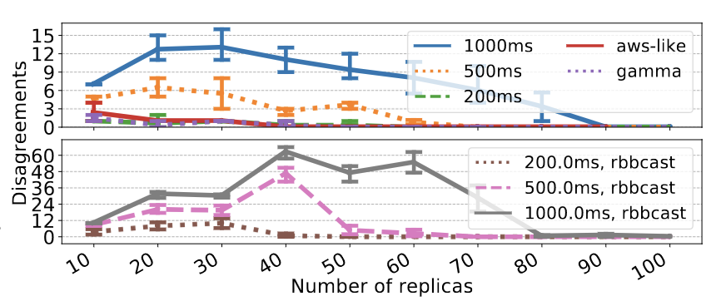
Number of Disagreements under Attacks
Disagreeing decisions for various uniform delays and for delays generated from a Gamma distribution and a distribution that draws from observed AWS latencies, when equivocating while voting for a decision (top), and while broadcasting the proposals (bottom), for
f = ⌈5n/9⌉ − 1.
Error bars are 95% confidence interval.
The University of Sydney

Slide 21
Zero Loss Payment Application

Slide 22
Zero Loss Payment Application Assumptions
Assets are fungible
Attacker can fork into a branches maximum and transfer a maximum gain G
Each consensus participant deposits 0.3G/n coins that are kept for m blocks
A transaction is committed if it reaches block depth m
Byzantine replicas cannot communicate infinitely faster than honest replicas in different partitions
The University of Sydney

Slide 23
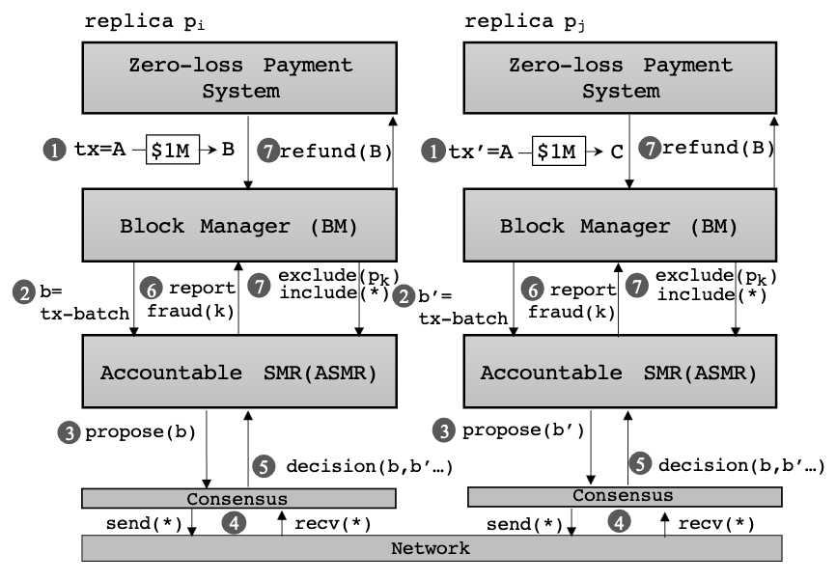
Zero Loss Payment Application
Consider that Alice (A) has 1M coins initially and tries to double spend.
Alice hacks the code of node p_{k} to lead p_{i} and p_{j} to disagree about b and b’ blocks.
The Accountable SMR detects the misbehavior of p_{k} and uses the deposit of p_{k} to refund Bob (B).
The University of Sydney

Slide 24
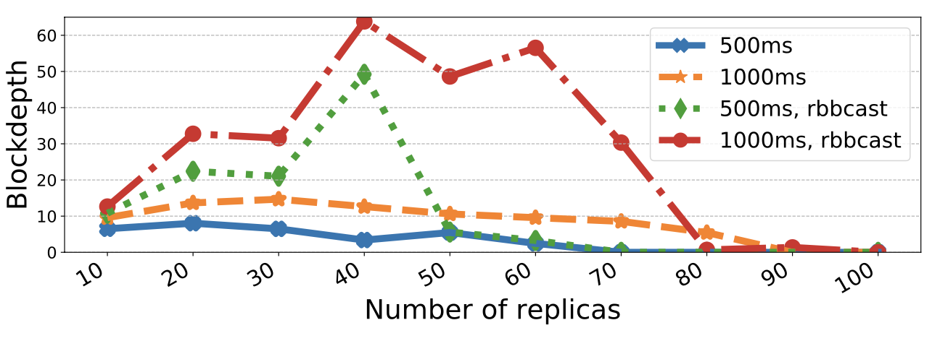
Zero Loss Payment Application
Minimum finalization blockdepth m to obtain zero-loss payment app Failures f = ⌈5n/9⌉−1
The University of Sydney

Slide 25
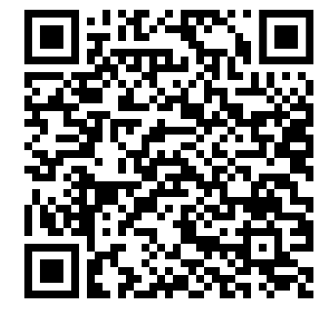

Conclusion
Prior to this work, blockchains could not tolerate a majority of failures.
ZLB tolerates a majority of failures by building upon:
Recent advances on the Accountable Consensus problem
The failure paradigm shift between closed networks and open blockchain networks
ZLB leverages the superblock optimization to scale well and achieves similar performance as Redbelly with 90 geodistributed consensus participants.
It allows to implement a zero-loss payment system, which rolls back conflicting transactions with deposited coins, which prevents double spending.
More information
Redbelly Network
The University of Sydney

Slide 26
Backup

Slide 27
Why f < 5n/9 ?
In Polygraph, honest replicas identify f_d >= n/3 faulty replicas
Even if honest replicas do not agree on the same replicas, they will eventually ban the same set of replicas within the static period of the adversary to obtain n’ consensus participants
Since n’<= n-f_d and f’ = f-f_d, we have that the number of faulty participants not excluded is f’ < n’/3 (1)
Since n’/3 <= (n-f_d)/3 and f_d >= n/3, this means that n’/3 <= n/3-n/9 (2)
The conjunction of (1) and (2) leads to f’<2n/9. By choosing f < 5n/9, we guarantee that f – f_d < 2n/9.
The University of Sydney

Slide 28
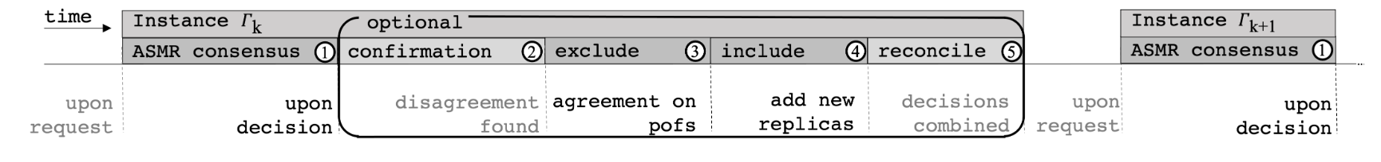
Longlasting Blockchain Problem
time
Consensus for index k
Consensus attempt 1: failure
Consensus attempt 2: failure
Consensus attempt j: success
The University of Sydney

Slide 29
The University of Sydney

Slide 30
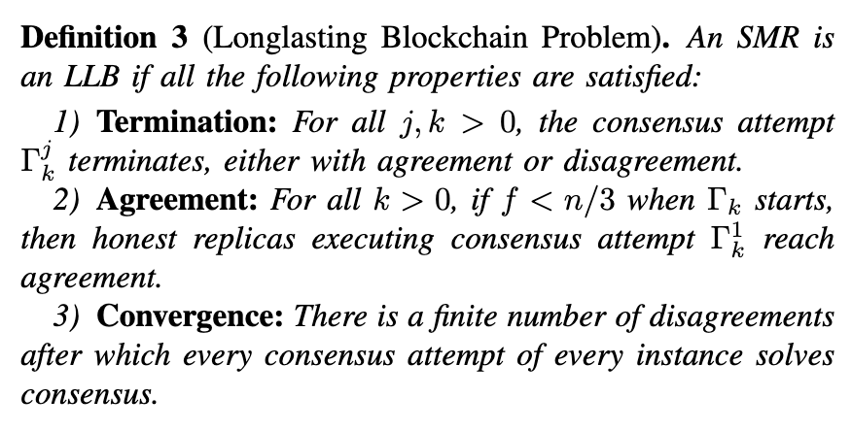
Longlasting Blockchain Problem
The University of Sydney

Slide 31
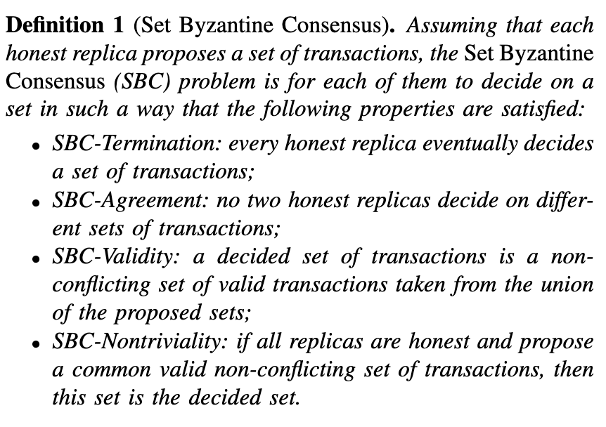
Set Byzantine Consensus
Red Belly: A secure, fair and scalable open blockchain. T Crain, C Natoli, V Gramoli. IEEE Symposium on Security and Privacy (S&P), 466-483, 2021
The University of Sydney

Slide 32
The University of Sydney

Slide 33
The University of Sydney

Slide 34
The University of Sydney

Slide 35
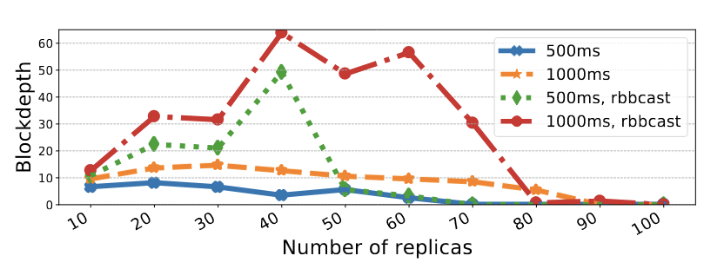
The University of Sydney

Slide 36
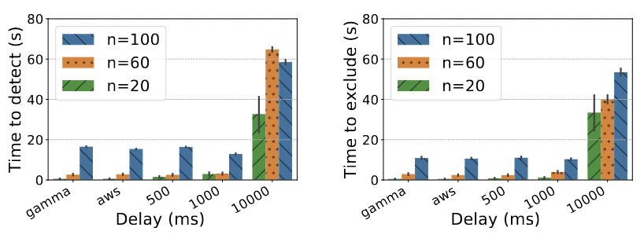
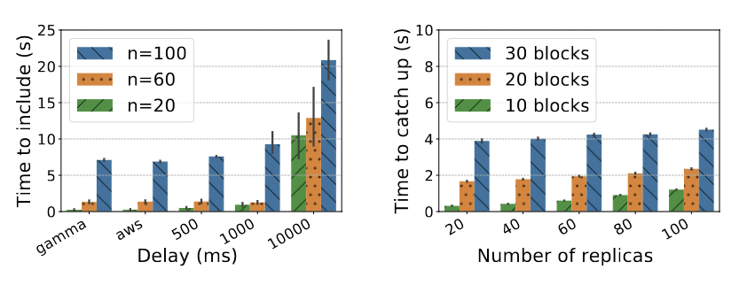
The University of Sydney

Slide 37
Project Quality & Innovation
What is the significant gap in knowledge or problem?
What is your innovative solution?
What methods and/or conceptual/theoretical framework will be used in the project?
What is the anticipated new knowledge that will be created by the project?
5) How might the research result in economic, environmental, social and/or cultural benefits to Australia?
The University of Sydney

Slide 38
Blockchain
GB
Initially, there is a genesis block (GB) that all nodes is aware of.
The University of Sydney

Slide 39
Blockchain
GB
Then nodes try to append a new unique block at the next available index
The University of Sydney

Slide 40
Blockchain
GB
Nodes may disagree about the next block that should appended
The University of Sydney

Slide 41
Blockchain
GB
This is why it is crucial to eventually agree on the uniqueness of the block to be appended
The University of Sydney

Slide 42
Blockchain
GB
If not resolved rapidly, this leads to double spending (theft or loss of assets)
The University of Sydney

